Slide 1
GLITCHCON – 25 TBG3-ExamSafe : Examination Management App
Team name : cache us ( team number 35 )
Team members : Krishnan Narayanan ( 22bCE1139 ), Jayarhupika g ( 22bce1665 ) , sahana s (22bce5195), abishek arun (22bce1063), mohammed asif (22bce1634 )

Slide 2
DEMO LINK
VIDEO 1 - https://drive.google.com/file/d/1YrZ9LA-qPhxWF7R_qYozgivVCddF6Sie/view?usp=drive_link
VIDEO 2 -https://drive.google.com/file/d/17tFEilquvfiC0FGI4rlO6aXQrj_o8LnW/view?usp=drive_link
VIDEO 3 - https://drive.google.com/file/d/1HjLH21sGHXbhHnayQ6UPq9PvIlpLQrjP/view?usp=drive_link

Slide 3
PROBLEM STATEMENT & CHALLENGE
Problem Statement
With the rise of online education, universities and institutions need a robust, secure, and scalable system to conduct Multiple-Choice Question (MCQ)-based exams. A well-designed system ensures fair assessments, prevents cheating, and provides automated grading for quick and efficient evaluation.
Challenge:
Develop an Examination Management App focused exclusively on MCQ-based assessments. The system should allow faculty to create exams, students to take exams, and admins to monitor and analyze performance. The entire process should be seamless, secure, and scalable.

Slide 4
CORE FEATURES OF ExamSafe
User Authentication & Role-Based Access: Admins, Faculty, and Students having distinct privileges.
MCQ Exam Creation & Management: Faculty are able to create exams with a pool of MCQ questions and also generate questions from AI when topic name is given as input
Options to set time
Automated Grading & Result Generation: The system should automatically evaluate student responses.
Results are available upon submission instantly.
Real-Time Exam Monitoring: Track student progress and prevent exam reattempts.
Question Bank Management: Faculty should be able to create, update, and reuse a question pool.
Secure & Cheat-Prevention Measures: Prevent multiple logins from the same account using extensions and AI based tracking
Enforcing session tracking and full screen enforcement
Live Timer & Auto-Submission on Timeout.
Detailed Performance Analytics for Students & Faculty.

Slide 5
IMPLEMENTATION OF FEATURES
Face Authentication and recognition is done using AWS S3 Buckets fir during signing in
For AI generating questions, the teacher has to enter the topic or subtopic’s name and then questions will be generated and from those choose the required questions for the test.
For monitoring and tracking during Tests,
AI Monitoring is done to
Detect 2 or more faces in the camera
Detect if person is looking away from the camera for a long time or move away from the camera
Extension is enabled to
Close forcefully all the other extensions
Avoid tab switching
Enforce full screen during tests

Slide 6
NOVELTY
AI-Generated MCQ Questions – Faculty can enter a topic, and AI will generate relevant MCQs automatically, making exam creation faster and more efficient.
AI-Based Exam Monitoring – Uses face recognition and AI tracking to detect multiple faces, gaze movement, and prevent cheating.
Browser Extension Enforcement – A dedicated browser extension that force-closes unnecessary tabs, prevents switching, and ensures full-screen mode.
Real-Time AI Proctoring – Detects suspicious activities such as looking away for long periods or moving away from the camera.
Automated Secure Authentication – AWS S3-based face recognition system ensures only the right student accesses the exam.
Instant AI-Powered Grading – Eliminates manual evaluation with instant results and performance analytics.
Scalable & Secure Infrastructure – Built using NextJS, Flask, AWS, and Gemini API, ensuring high security and scalability for large institutions.

Slide 7
TECH STACK
FRONTEND : NextJS, TailWind, JavaScript, HTML, CSS
BACKEND : Python, Flask, AWS
AI Features : FaceMesh, Gemini API, ManifestV3

Slide 8
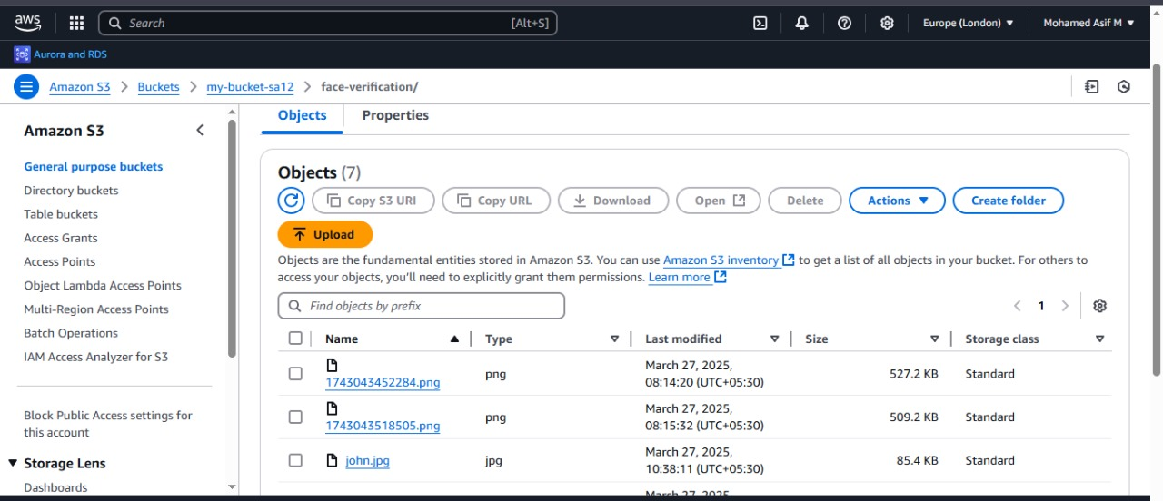
AWS Implementation

Slide 9
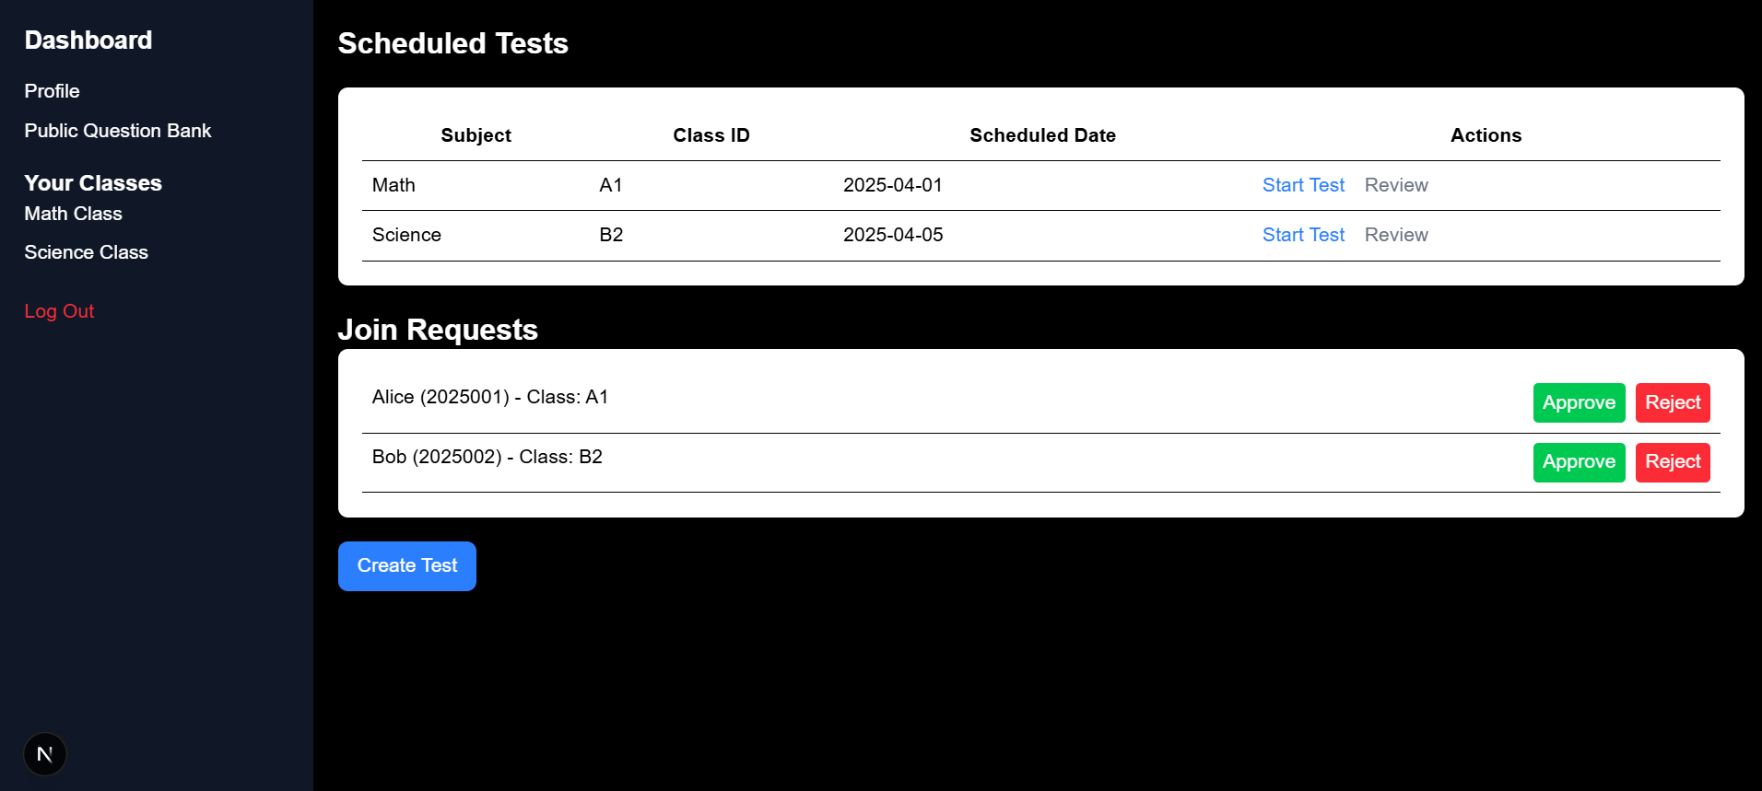
DASHBOARD

Slide 10
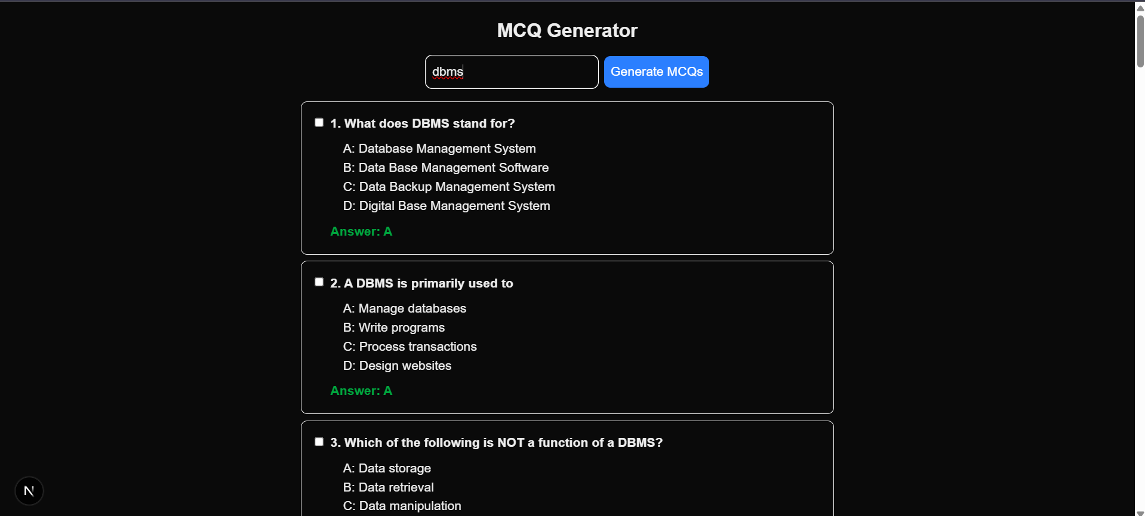
AI BASED MCQ GENERATION

Slide 11
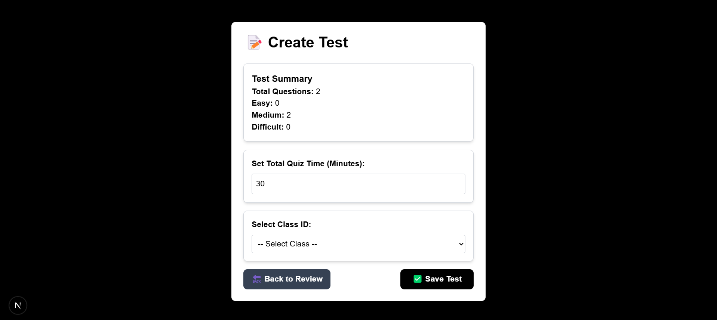
TEST CREATION

